Slide 1
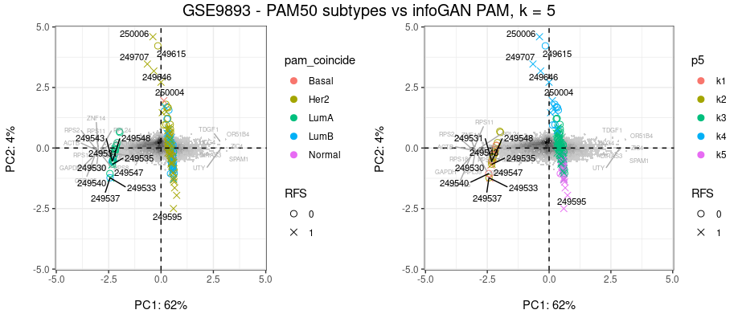
GSE9893 is a transcriptomic microarray data set from a study* of 132 breast cancer tumor samples from patients receiving tamoxifen adjuvent therapy after radiation and surgical treatment. Relapse free survival (RFS) was established after minimum 5 years follow-up.
Tamoxifen is a selective estrogen receptor modulator used for the treatment of both early and advanced estrogen receptor-positive (ER-positive or ER+) breast cancer. The spectral biplots below show samples labeled with PAM50 subtypes on the left and subtypes from PAM clusters (partition around medoids, k = 5) of of the 48 dimensional reduced vectors generated using infoGAN on a dataset combining GSE9893 and 14 other studies (n = 2237, expression levels for 8832 genes).
*Chanrion M, Negre V, et al. A gene expression signature that can predict the recurrence of tamoxifen-treated primary breast cancer. Clin Cancer Res. 2008 Mar 15;14(6):1744-52. doi: 10.1158/1078-0432.CCR-07-1833. PMID: 18347175; PMCID: PMC2912334.

